Slide 1
Lab 2: ER Model
CS460 Fall 2021
Tarikul Islam Papon

Slide 2
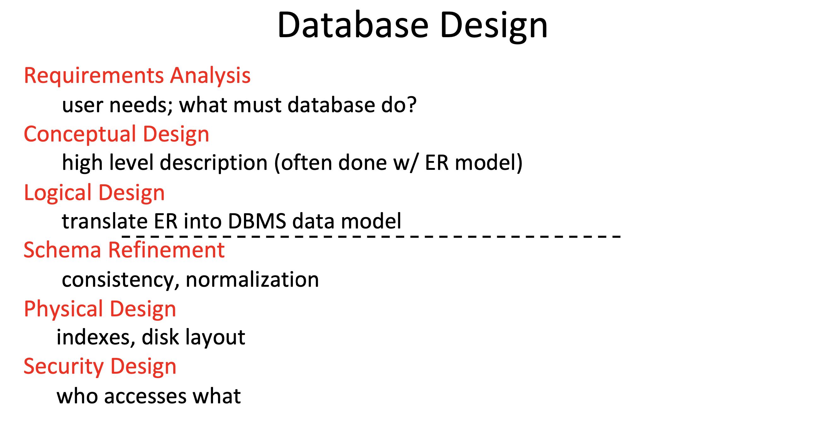

Slide 3
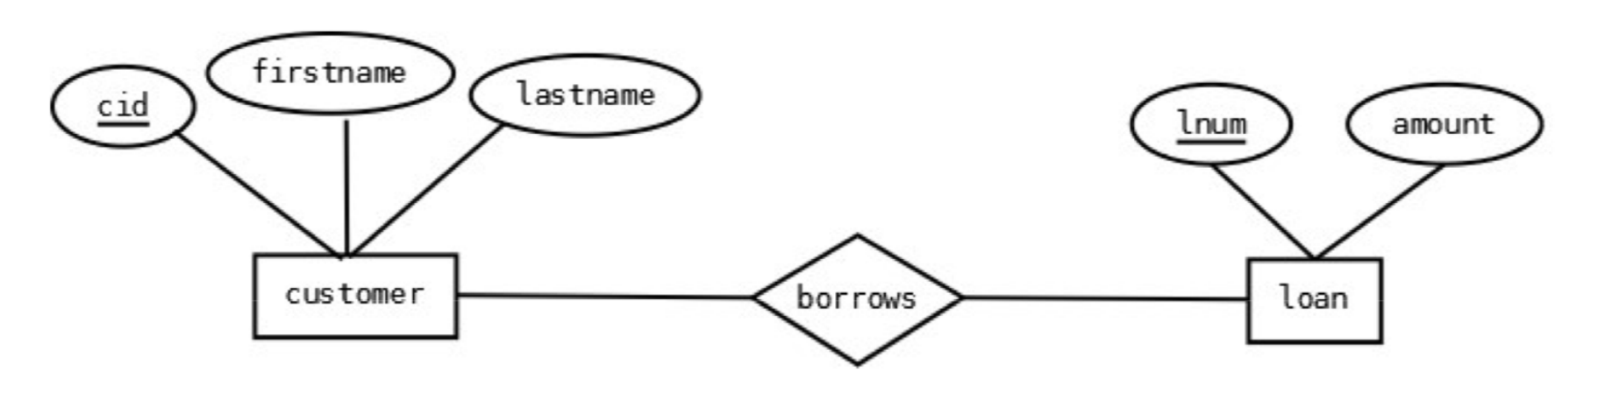
ERD Basics
Entity (Rectangle): An Entity is an object in real world that is distinguishable from surrounding environment. They have a primary key, distinguishing each occurrence of the entity.
Relationships (Diamond): Relationships are associations between or among entities.
Attributes (Oval): Attributes are characteristics of an entity or a relationship. Underlined attributes indicate primary keys. Dashed oval indicates derived attributes.

Slide 4
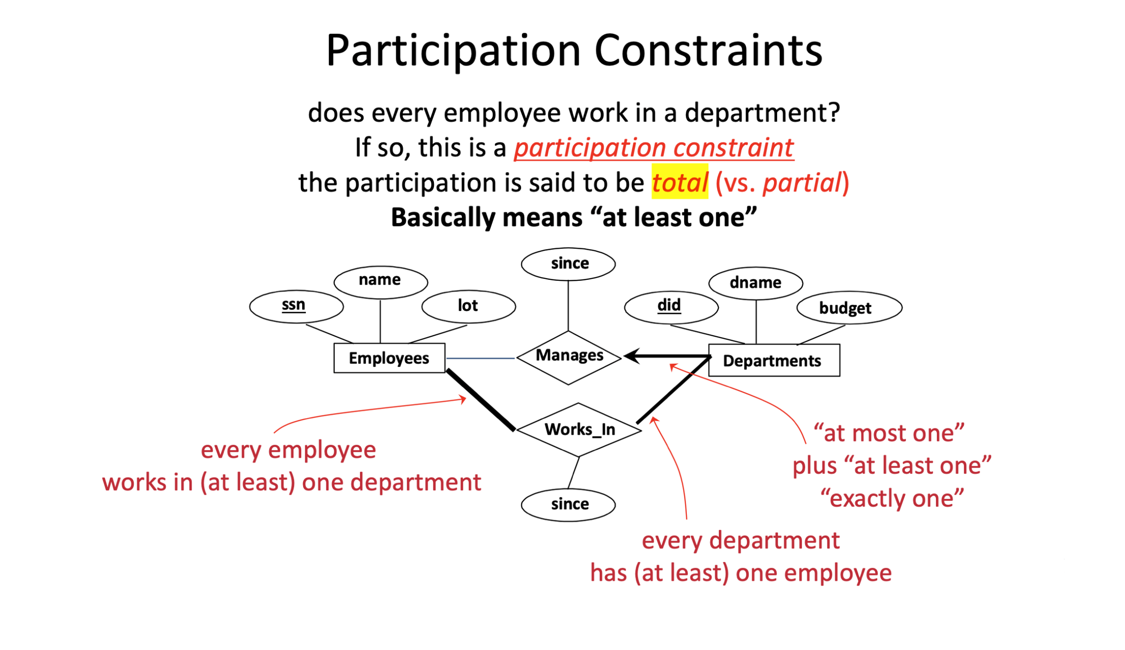

Slide 5
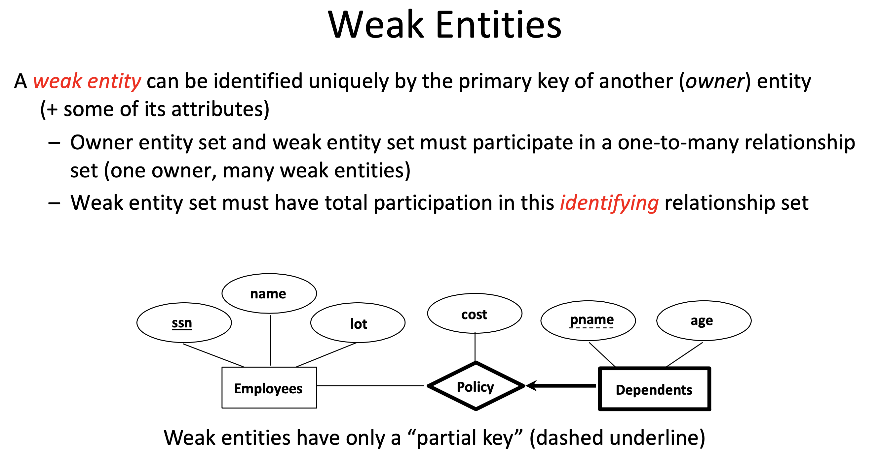

Slide 6
Exercise
go to https://www.draw.io

Slide 7
Transform ERD to Table
Convert all the Entities in the diagram to tables.
All single valued attributes of an entity is converted to a column of the table
Key attribute in the ER diagram becomes the Primary key of the table.
Declare the foreign key column, if applicable.
Any multi-valued attributes are converted into new table.
One can ignore derived attribute, since it can be calculated at any time.
Weak entity is also represented as table. Add a foreign key column, which would be the primary key of its strong entity. This foreign key column along with its key attribute column forms the primary key of the table.
All many-to-many relations will be a table

Slide 8
SQL Example
CREATE TABLE Persons (
PersonID int,
LastName varchar(255),
FirstName varchar(255),
Address varchar(255),
City varchar(255)
);
INSERT INTO Persons
VALUES (1, 'Hopkins', 'Anthony', '111 Cummington Mall', 'Boston’);
INSERT INTO Persons
VALUES (2, 'Bale', ‘Christian', ‘730 Comm Ave', 'Boston’);
SELECT * FROM Persons;
SELECT * FROM Persons WHERE LastName LIKE ‘Bale’;

